Slide 1
1
4
Effect of Patients features on resting blood pressure
By John Ifedili
1.Abstract.
2. Project Description.
3. Problem.
4. Purpose of the study.
5. Methods.
6. Analysis.
7. Analysis and Results.
8. Analysis and Results.
9. Summary.
10. Future Research.
2
3
1
4
2
6
5
3
6
4
8
7
8
6
6
9
10
10 4

Slide 2
ABSTRACT
High blood pressure is when the resting blood pressure is greater than 130/80 mm/Hg Systolic/Diastolic.
Patients factors like diabetes are known to worsen high blood pressure over time. However, the relationship has not been clearly established using a data set.
The objective of this work was to measure the relationship between patient features and the systolic resting blood pressure using data from the UCI machine learning heart repository.
Fasting blood sugar and slope were the highly ranked features related to resting blood pressure. Guassian Naïve Bayes(58%) had the best machine learning algorithm for prediction.

Slide 3
Project Description
Data was loaded from the UCI heart disease repository from Kaggle.
It was explored and various data visualization techniques were deployed to understand the data. Feature engineering techniques were also deployed to transform the data into formats that make machine learning algorithms effective.
The performance of these machine learning algorithms were evaluated . And a conclusion was made on the relationship between the features and the resting blood pressure.

Slide 4
Problem
Some Patient associated conditions like chest pain and high fasting blood sugar might affect resting blood pressure and could contribute or worsen hypertension. Our goal is to validate this claim by using a public data set to observe trends in this data set related to resting blood pressure.

Slide 5
Purpose of the study
if we can understand the factors that are associated with high blood pressure, we can ensure that facilities have systems in place to monitor blood pressure of patients when these associated factors are present or are elevated.
We can also measure relationships between other types of features with Categorical variables with similar methods.
Lastly, health Researchers need a guide from Data Scientists to conduct further research and reduce waste of time and money on projects that might not yield results.

Slide 6
Methods
Data Loading
Data exploration
Data visualization techniques
Supervised learning classification algorithm
Confusion matrix

Slide 7
Analysis
Features sorted by their rank: [(1, 'fbs'), (1, 'slope_0'), (1, 'slope_1'), (2, 'age'), (3, 'cp_3'), (4, 'cp_1'), (5, 'oldpeak'), (6, 'thal_2'), (7, 'thal_1'), (8, 'cp_2'), (9, 'thal_0'), (10, 'trest_band'), (11, 'exang'), (12, 'restecg'), (13, 'sex'), (14, 'thal_3'), (15, 'ca'), (16, 'thalach'), (17, 'cp_0'), (18, 'chol')]
Fasting blood sugar and slope had the greatest effect on the resting blood pressure. The best machine learning algorithm for prediction of resting blood pressure was Guassian Naïve Bayes.

Slide 8
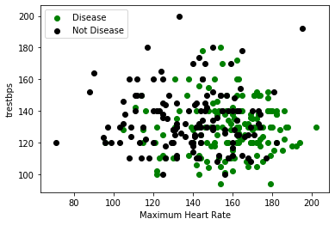
Analysis and Results
As the maximum heart rate increased,
more people had heart disease.

Slide 9
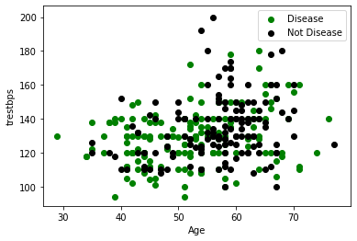
There was no consistent
Relationship between age and
Resting blood pressure

Slide 10
Summary
Fasting blood sugar and slope were the best predictors of the resting blood pressure
Guassian Naïve Bayes(60%) had the best machine learning algorithm to predict the resting blood pressure.
There appeared to be a relationship between most features and resting blood pressure.

Slide 11

Future research
Data analysis and Machine learning could be used as a guide for Medical researchers for great research that would save time and money.

